Slide 1

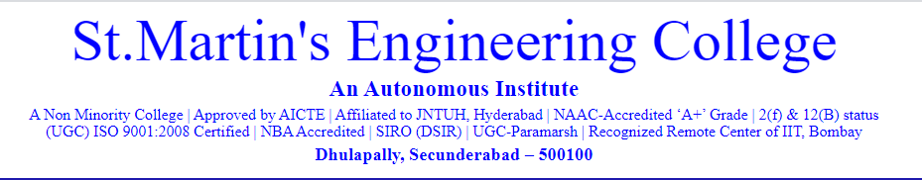

Alumni Management System
Batch 10
Medam Sai Sirisha – 16K81A05E7
Ashish Kamatala – 16K81A05D5
Siddharth Ramawat – 16K81A05G8
Guide : Dr. Govinda Rajulu G.

Slide 2
TABLE OF CONTENTS
Abstract
Domain Discussion
Description about base paper
Issues in Existing System
Proposed System
Discussion on Modules
Results
Conclusions and limitations of Proposed System
Challenges
Future Work
References

Slide 3
Abstract
Alumni management is one of the thrust areas considered focal to institutional development mostly in developing countries.
A strong alumni system plays an important role in reaping enormous benefits for student-student networks as well as institution-student networks.
A major problem with some of the existing systems is the details of any student is exposed to anyone on the web.
Our system proposes an easy and interactive management portal for creating networks among students as well as institutes.The portal allows currently enrolled students as well to create network with graduates of the organization, helping them for their careers through job referrals or for future advice. The system validates the students enrolled to the organization based on their Registration Number collected from the Institute/Organization.

Slide 4
Domain Description
Web programming, also known as web development, is the creation of dynamic web applications.
Web development can range from developing a simple single static page of plain text to complex web-based internet applications (web apps), electronic businesses, and social network services.It includes aspects such as web design, web publishing, web programming, and database management.
Examples of web applications are social networking sites like Facebook or e-commerce sites like Amazon.
In fact, many argue it’s the best form of coding for beginners to learn. It’s easy to set up, you get instant results and there are a lot of online resources, videos and documentation of various technologies available.
People today are learning web development because they want to create a new startup or find a job in the industry. No matter whether you’re looking for a career or just want to learn coding, learning how to develop for the web is for you. It’s one of the smartest decisions you will ever make.

Slide 5
Front end Development
Front end development mainly refers to the construction of web pages that are loaded when the user starts a web application, basically the User Interface, and how the web page responds and handles the events which are fired by the user by interacting with components on the webpage.
For front-end development there are many booming technologies coming up which mainly are based on HTML, CSS, Javascript .
HTML expands itself as Hypertext Markup Language, is a special code for ‘marking up’ text in order to turn it into a web page. Every web page on the net is written in HTML, and it will form the backbone of any web application. CSS, short for Cascading Style Sheets, is a code for setting style rules for the appearance of web pages. CSS handles the cosmetic side of the web. Finally, JavaScript is a scripting language that’s widely used to add functionality and interactivity to web pages.

Slide 6
Back end Development
Back-end development controls what goes on behind the scenes of a web application. A back-end often uses a database to generate the front-end.
Back-end scripts are written in many different coding languages and frameworks, such as:
PHP
Ruby on Rails
ASP.NET
Perl
Java
Node.js
Python

Slide 7
Cont..
Back end developers are most focused on a site’s responsiveness and speed. These languages are used to create dynamic sites which are different from static sites in that these types of websites store database information. Content on the site is constantly changing and updating. Examples of dynamic sites include Facebook, Twitter, and Google Maps.
Backend development languages handle the ‘behind-the-scenes’ functionality of web applications. It’s code that connects the web to a database, manages user connections, and powers the web application itself. Backend development works in tandem with the front end to deliver the final product to the end user.

Slide 8
Android Development
Android software development is the process by which new applications are created for devices running the Android operating system. Google states that "Android apps can be written using Kotlin, Java, and C++ languages" using the Android software development kit (SDK), while using other languages is also possible. All non-JVM languages, such as Go, JavaScript, C, C++ or assembly, need the help of JVM language code, that may be supplied by tools, likely with restricted API support.
Mobile app development is the creation of software intended to run on mobile devices and optimized to take advantage of those product's unique features and hardware. Mobile application development is the process of creating software applications that run on a mobile device, and a typical mobile application utilizes a network connection to work with remote computing resources. Hence, the mobile development process involves creating installable software bundles (code, binaries, assets, etc.) , implementing backend services such as data access with an API, and testing the application on target devices.

Slide 9
Description About Base Paper
The paper “Centralized Alumni System- A Prototype Proposal” proposes a system which is institution dependent.There are systems developed for students studying in any educational institute who are above the age of 15.
“Online Alumni System “ proposes a system which allows anyone on the web to access and search information about any student. “Alumni Network Analysis“ is a system that evaluates educational institutes and ranks them based on the data collected about the network connections of alumni in the entrepreneurial and technological domain.
Alumni management is one of the thrust areas considered focal to institutional development [ HYPERLINK \l "Rub11" 1 ], mostly in developing countries. A strong alumni system plays a vital role in reaping enormous benefits 2]for student-student networks as well as institution-student networks.

Slide 10
Literature Survey
Alumni are the living examples and testimonials of any organization. It’s because of the strong alumni network that leads to the recognition and fame of the college.
A constant and active involvement of the alumni with the institute proves to be very useful for the college as well as students.
Alumni Management System is used to connect with the students who have passed out of the college(ex-students).
An Online Alumni Tracking System is an example of web application which is under the information systems. It helps an academic institution in tracking its alumni. Also, it helps the alumni to communicate with the institution through the use of the internet. It also helps the alumni to get updated with the latest news and upcoming events of the institution.

Slide 11
Cont..
RELATED WORK
The paper “Centralized Alumni System- A Prototype Proposal” proposes a system which is institution dependent. There are systems developed for students studying in any educational institute who are above the age of 15.
“Online Alumni System “proposes a system which allows anyone on the web to access and search information about any student.
“Alumni Network Analysis“ is a system that evaluates educational institutes and ranks them based on the data collected about the network connections of alumni in the entrepreneurial and technological domain.
Features of an Alumni Information System
According to Webaloo (2007) an alumni builders systems features includes the following: Alumni class page- a directory of alumni names by class year with links to individual profiles and email addresses; Alumni Profile – is controlled by individual users and displays only the information that he/she wants to display; Alumni Search – allows the users to search by name, class, occupation, address, etc.; Alumni Forum – offers alumni a way to stay in touch with classmates and friends form other graduation years; Alumni Notes – allows classmates to communicate by posting on a notes page; Secure Log-in – use to block sensitive alumni information from other school constituents; Profile Change Report – allows the school to keep track of the personal information that alumni can update; and Missing Alumni Page – helps the school reconnect with graduates whose personal information is outdated.
23.05.2020

Slide 12
Cont..
Web-based Alumni Information System of West Negros University
The web-based Alumni Information System of West Negros University (2010) is capable of gathering information of all the alumni using the web application form. The system helps the administrator, alumni personnel and even the public relation office in maintaining the data and can easily send and display information for all concerns.
The system is internet-based that can access all online portals and connect to all networks that enable to collect all the data as needed by the university particularly by the alumni office. The system is also a social network that provides space for chatting, forum blog and photo gallery functions.
On Student Information
In the study conducted by Agudera and Mendiola (2013) the implementation of Alumni Information System, the system will be secured, the process in having the student information will become faster, and accurate generating reports.
The system will secure student files using the log-in log-out form for the unauthorized users. The developers design the interface so the users will understand the system easily and use the Microsoft Access for database to store important information.
The system will help a school to be well-organized.
23.05.2020
Department of Computer Science & Engineering 12

Slide 13
ISSUES IN EXISTING SYSTEM
The existing study stated shows that alumni information system contributes to a good relationship between them and the school. It is also used for rating and ranking the college.
The existing studies designs, and implementations get involved the web as well as the Online Alumni Information System and enables alumni to interact with each other. It also provides career service opportunities to all the graduates of the college.
Existing system is a manual one in which users are maintaining documents paper work to store the information like colleges details, student details. It is very difficult to maintain historical data.
It is difficult to maintain important information in documents paper work. More manual hours need to generate required reports.
23.05.2020
Department of Computer Science & Engineering 13

Slide 14
Cont..
It is tedious to manage historical data which needs much space to keep all the previous years, ledgers, documents paper work.
“Online Alumni System “ proposes a system which allows anyone on the web to access and search information about any student.
“Alumni Network Analysis“ is a system that evaluates educational institutes and ranks them based on the data collected about the network connections of alumni in the entrepreneurial and technological domain.
There is no online communication between students and alumni.
23.05.2020
Department of Computer Science & Engineering 14

Slide 15
Proposed System
The goal of our application is to help university students to create networks and interact with alumnus of the university.
Through this system we hope to achieve student-alumni and alumni-institution interactions. The currently enrolled students of the institutions can contact their alumni working in various organizations or pursuing higher studies in other reputed institutions, this helps guide the students for their future, as they learn from the experiences of their seniors.
The basic function of the application is to provide registered and authorized users an easy and interactive way to create events, post feedbacks about the curriculum/infrastructure etc., create and edit blogs, view feed and most importantly get referrals and create network with the alumnus.
The registered users can also participate in the events that are created by other users. The users get notified about the same.
23.05.2020
Department of Computer Science & Engineering 15

Slide 16
Cont..
Our system is proposed for the alumni of various institutions across Telangana State, as there is no current existing system for the students of Tier - 3 colleges in Telangana.
The system also allows the institution to conduct events for the alumni such as the Alumni Meets for the alumni to get together and rendezvous with their batchmates providing a harmonious environment for them to interact with each other or alumni can post hiring events for existing students.
23.05.2020
Department of Computer Science & Engineering 16

Slide 17
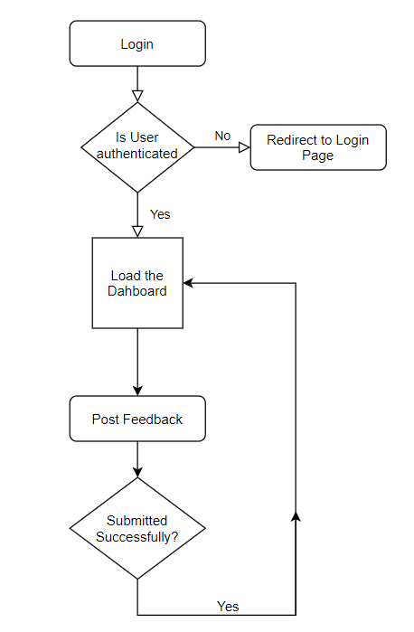
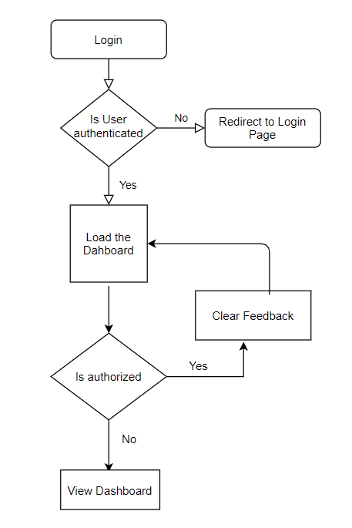
Feedback Flow Diagram
Post Feedback
Clear Feedback
23.05.2020
Department of Computer Science & Engineering 17

Slide 18
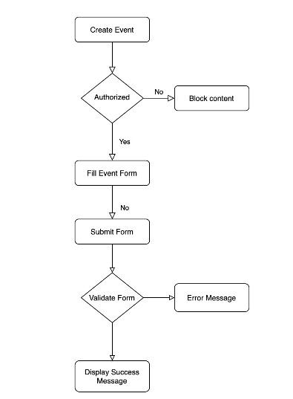
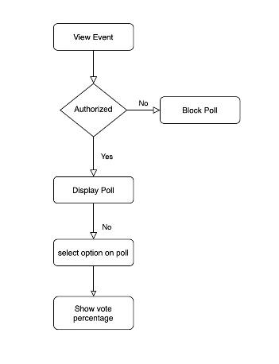
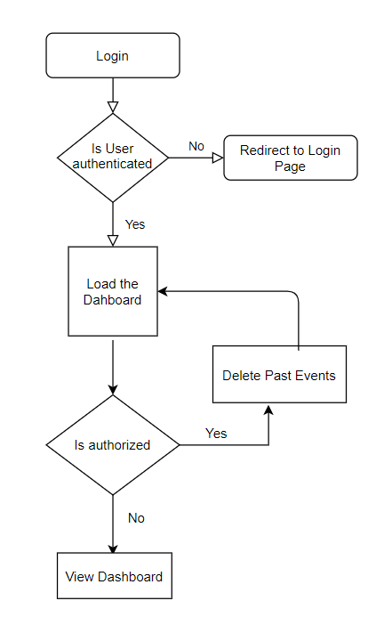
Events Flow Diagram
Create Events
View Events
Delete Events
23.05.2020
Department of Computer Science & Engineering 18

Slide 19
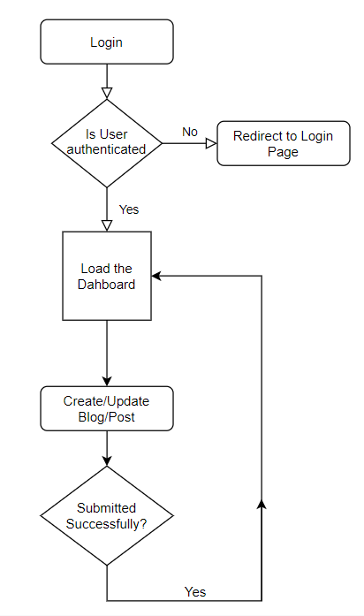
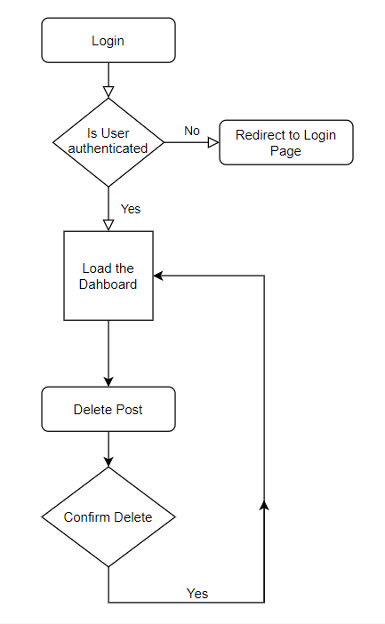
Blog Flow Diagram
Create/Update Blog
Delete Blog
23.05.2020
Department of Computer Science & Engineering 19

Slide 20
Objectives
Our system proposes an easy and interactive management portal for creating networks among students as well as institutes.
The system notifies all the users about the events posted by any of the registered users.
The system helps people build networks by providing a feature which allows them to search based on filters such as department, registration number or email id.
Also the system will is configured such that it takes feedback from users and only authorised users can view and handle the feedback.
There is no Alumni Management System for most of the colleges in “Telangana State”(Tier - 3). Hence our system will prove to be helpful for most of the colleges including our own college.
23.05.2020
Department of Computer Science & Engineering 20

Slide 21
Implementation Details
Users component: This component is used to login or sign up to the system. The new users are authorized by the admin, once they are authorized they can access the system by logging in. The user’s table is an extension to the default auth_user table provided by Django. Json Web token authentication is being used to authenticate users with the system. After successful login the user is directed to dashboard where he can view all the recent blogs, posts, events posted by other users. The password is stored using different hashing algorithm by default to secure the user passwords.
Blogs component : It is used to create , update and delete posts or blogs.
Events component: The events can be created by any authorized user. Events such as technical events, recruitment events, fests, seminars, lectures etc. can be created. The users can view the percentage of available slots for a particular event. They can register for a particular event. Once they register for an event, they get notified about any updates from the event organizer about the event. Mailgun is being used to send mails to the registered users for a particular event. The users can contact the organizer for the event information on mail.
Feedback component: The registered users can post feedback about curriculum, infrastructure, or general feedback. The feedback received by all users can only be viewed by the admin of the website, he can clear either entire feedback or can choose a particular date, the feedback posted till that date would be completely cleared.
23.05.2020
Department of Computer Science & Engineering 21

Slide 22
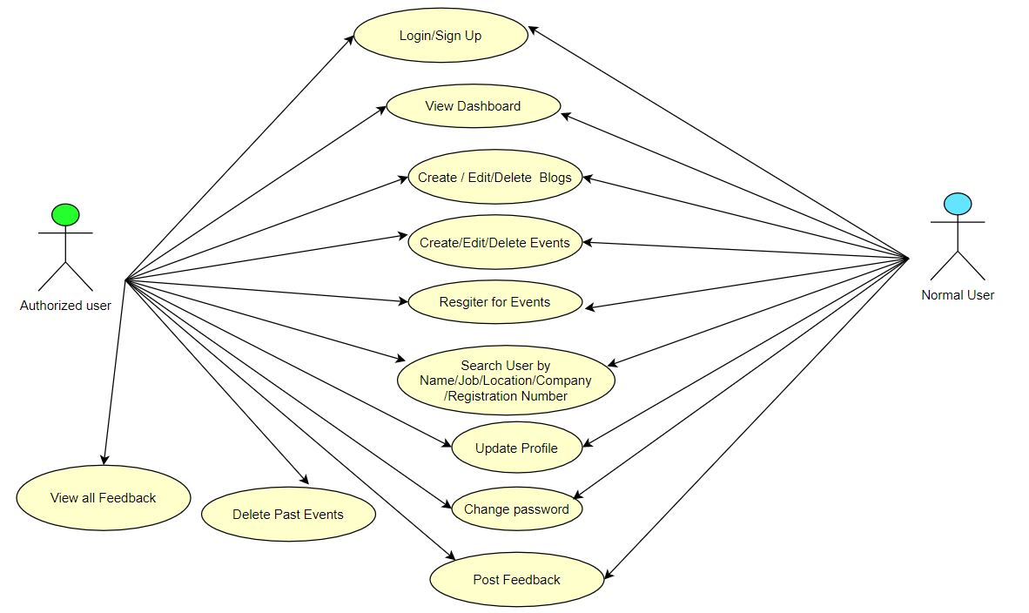
Use Case Diagram
23.05.2020
Department of Computer Science & Engineering 22

Slide 23
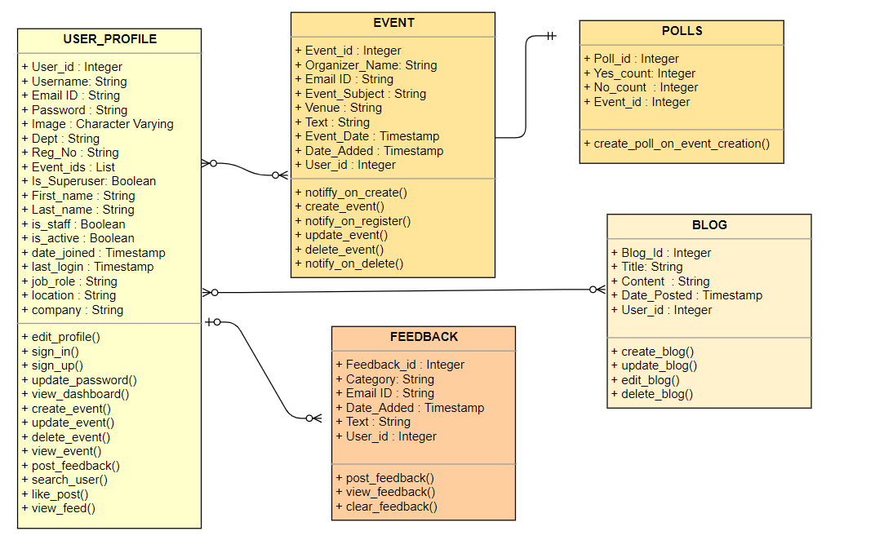
Class Diagram
23.05.2020
Department of Computer Science & Engineering 23

Slide 24





ANDROID
23.05.2020
Department of Computer Science & Engineering 24

Slide 25
Discussion on Modules
Event Module
The events can be created by any authorized user. Events such as technical events, recruitment events, fests, seminars, lectures etc. can be created.
The users can view the percentage of people attending for a particular event.
They can register for a particular event.
Once they register for an event, they get notified about any updates from the event organizer about the event.
Mailgun is being used to send mails to the registered users for a particular event.
The users can contact the organizer for the event information on mail.
23.05.2020
Department of Computer Science & Engineering 25

Slide 26
Blogs Module
The users can create posts.
The posts will be visible on the dashboard of the user’s home page.
The posts can be edited and deleted by the owner of the post.
The post can be about the experiences of the users, it can be anything related to technical knowledge / non technical knowledge or it can also be interview experiences of the users or alumni.
23.05.2020
Department of Computer Science & Engineering 26

Slide 27
Cont..
User Module
This component is used to login or sign up to the system.
The new users are authorized by the admin, once they are authorized they can access the system by logging in.
The user’s table is an extension to the default auth_user table provided by Django.
Json Web token authentication is being used to authenticate users with the system.
After successful login the user is directed to dashboard where he can view all the recent blogs, posts, events posted by other users.
The password is stored using different hashing algorithm by default to secure the user passwords.
23.05.2020
Department of Computer Science & Engineering 27

Slide 28
Cont..
FeedBack Module
The registered users can post feedback about curriculum, infrastructure, or general feedback. Posting General feedback is by default option.
The feedback received by all users can only be viewed by the admin of the website, he can clear either entire feedback or can choose a particular date, the feedback posted till that date would be completely cleared.
The admin can filter feedback search by criteria such as Infrastructure,General or Curriculum.
23.05.2020
Department of Computer Science & Engineering 28

Slide 29
Result and Discussion
On hitting the website the login page is shown where the users can either login if they are already registered or create an account.
If registered users login into the system, they are initially redirected to the dashboard. The dashboard has options to choose to create blog, create event. Search other users, update their profile, insert feedback.
The blog posted by users is visible on the feed of every other registered user on the system.
The events posted by users is also visible on the feed of every registered user. The users can choose to attend the event by clicking on the poll, if he hasn’t already voted in the poll.
The Feedback option is visible only to the admin of the system. The admin can view all feedback given by various users. The data about the user posting feedback is not stored hence remains anonymous for the admin. The admin can further check feedback based on filters such as Infrastructure, Curriculum and General(which is by default taken for all feedbacks).^{[8]}
If any user apart from admin tries to view the feedback the stalker alert page would be shown.
When a user searches for another user, he gets search results displayed. The searched user’s profile can be checked by others. In order have the details hidden , users can choose to keep their data private by setting their preferences.
23.05.2020
Department of Computer Science & Engineering 29

Slide 30
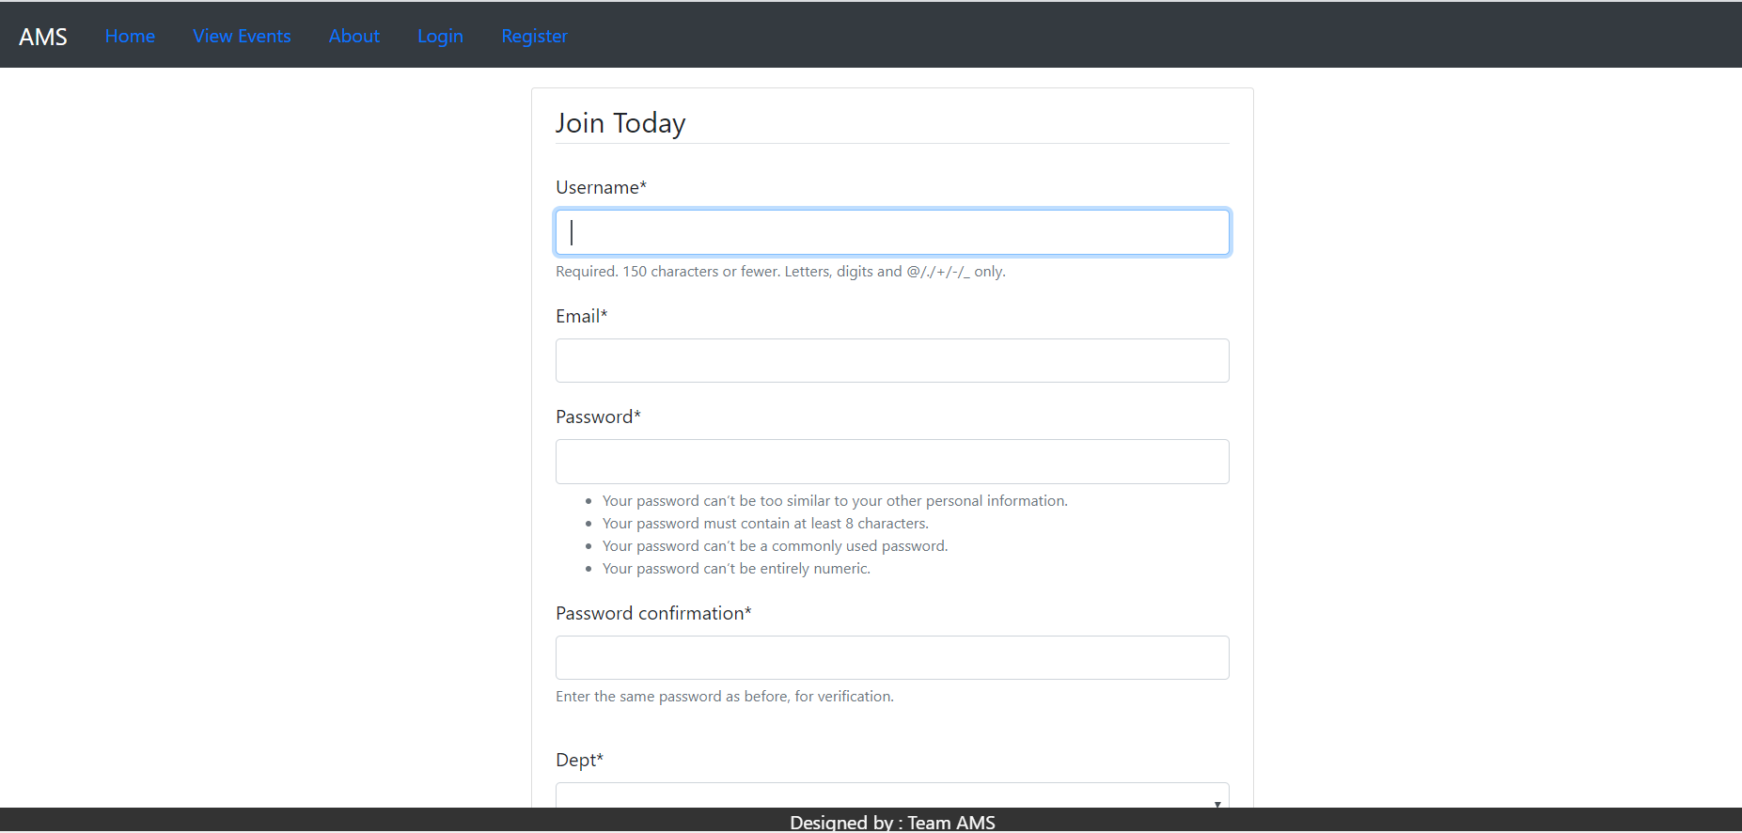
Output Screenshots
Fig 1 Register Page
23.05.2020
Department of Computer Science & Engineering 30

Slide 31
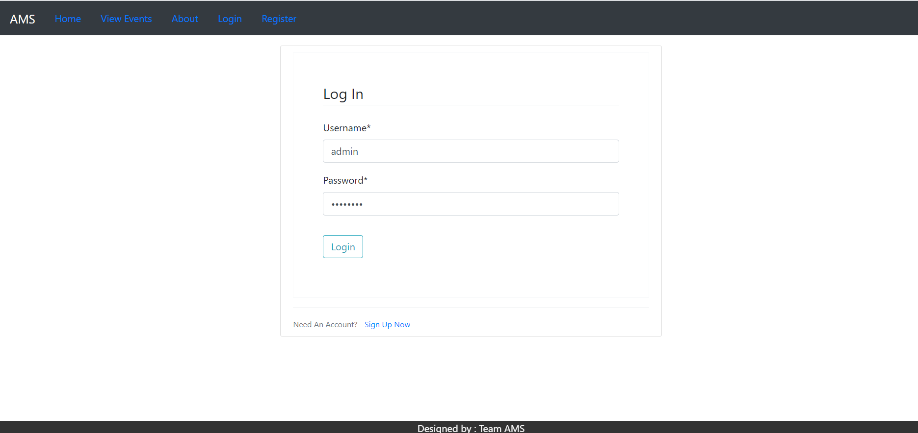
Fig 2 Login Page
23.05.2020
Department of Computer Science & Engineering 31

Slide 32
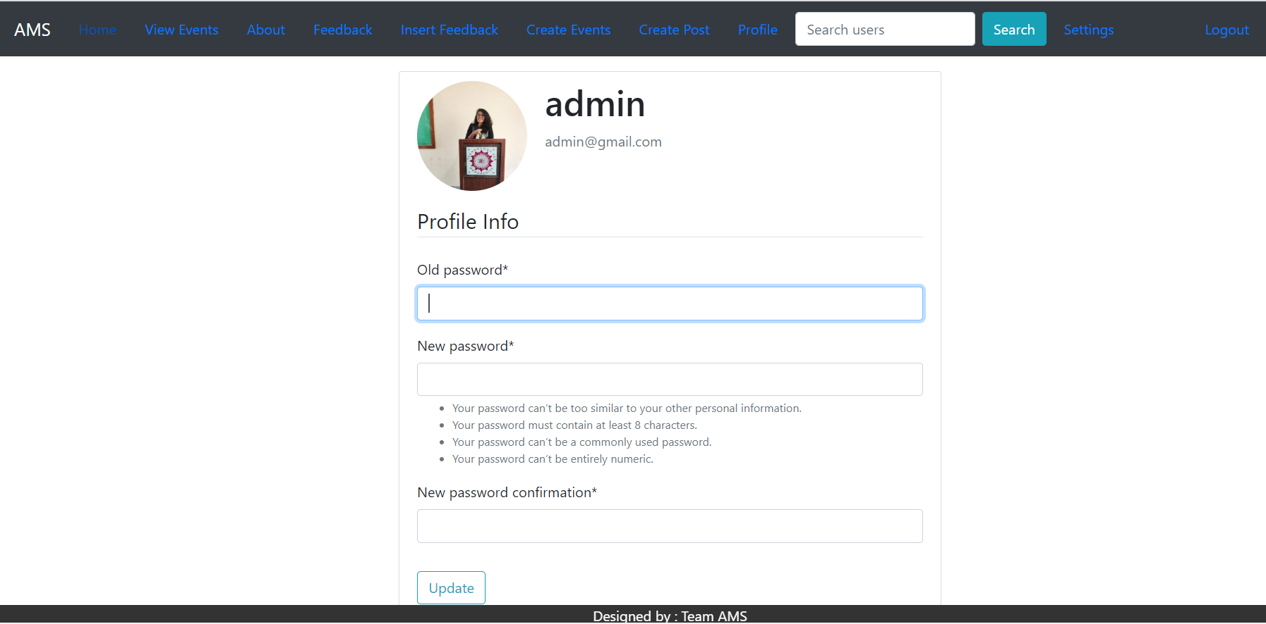
Fig 3 Change password page
23.05.2020
Department of Computer Science & Engineering 32

Slide 33
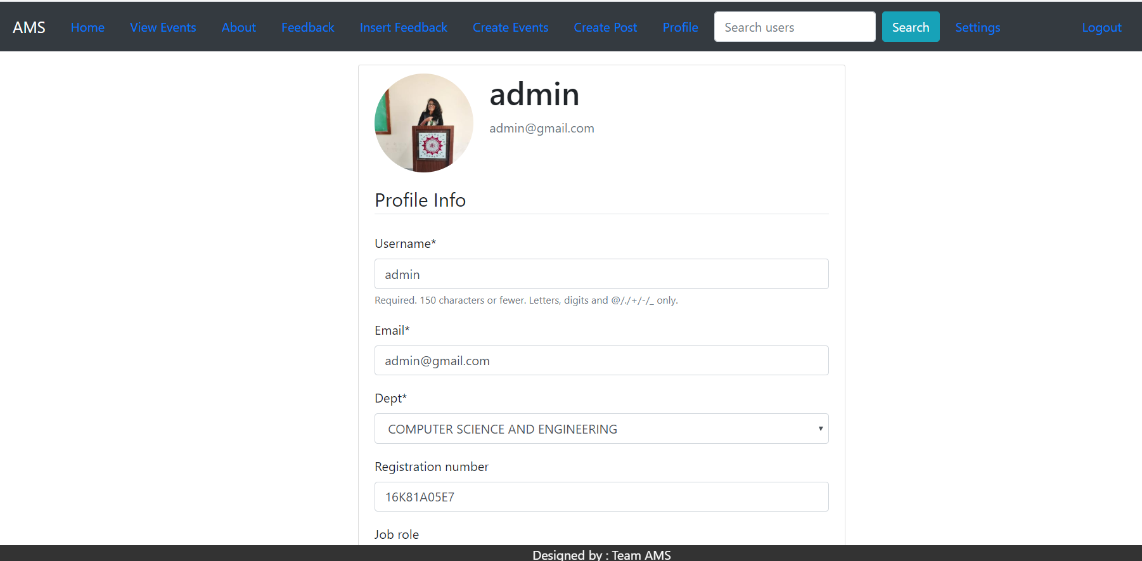
Fig 4 Profile Page
23.05.2020
Department of Computer Science & Engineering 33

Slide 34
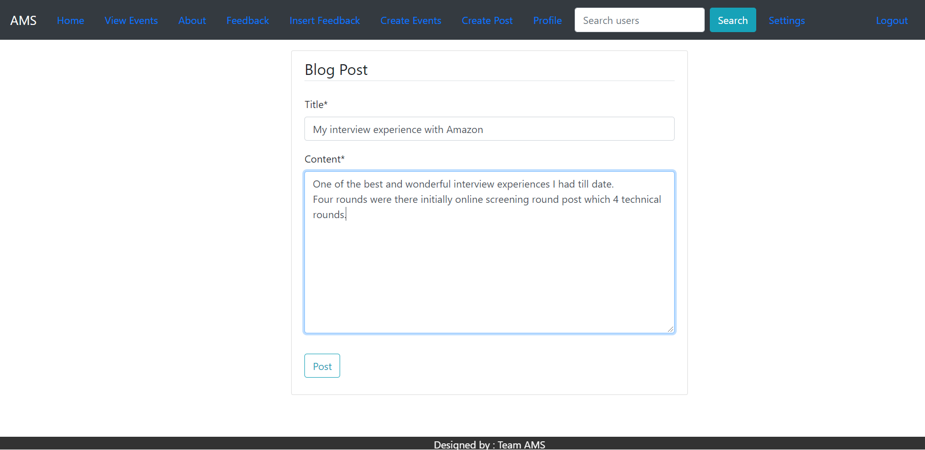
Fig 5 Blog Posting Page
23.05.2020
Department of Computer Science & Engineering 34

Slide 35
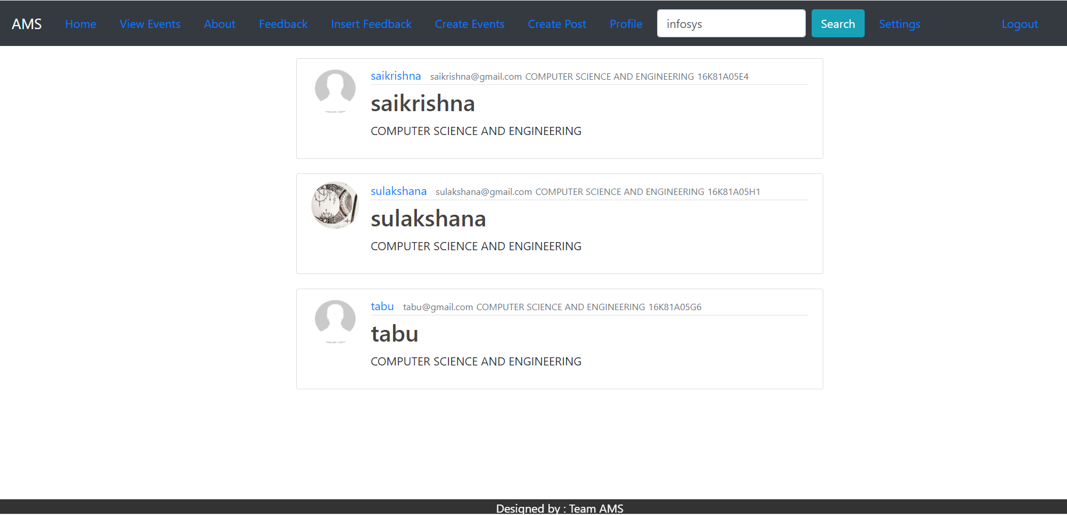
Fig 6 Search Results
23.05.2020
Department of Computer Science & Engineering 35

Slide 36
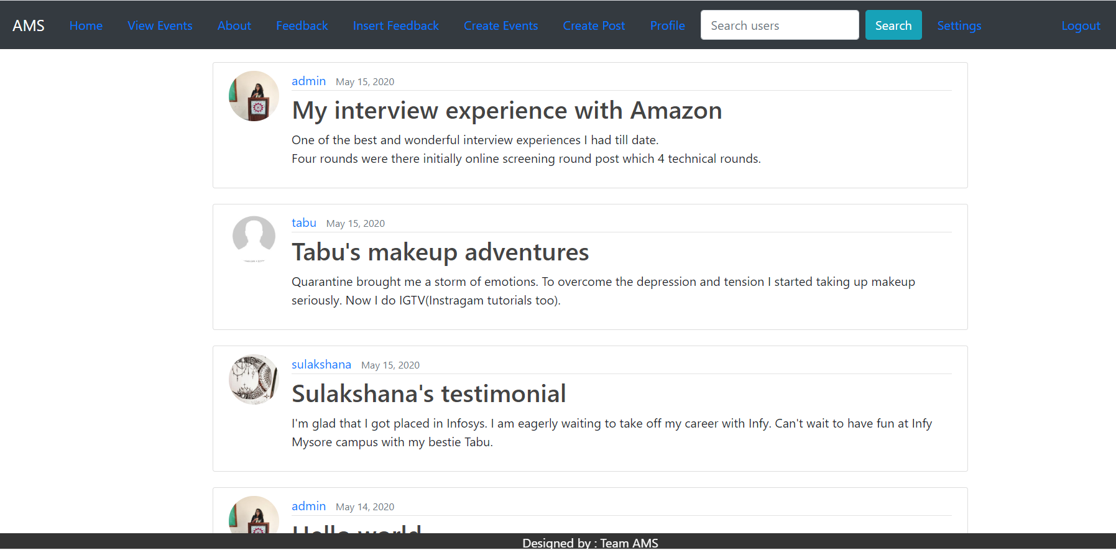
Fig 7 Home Page
23.05.2020
Department of Computer Science & Engineering 36

Slide 37
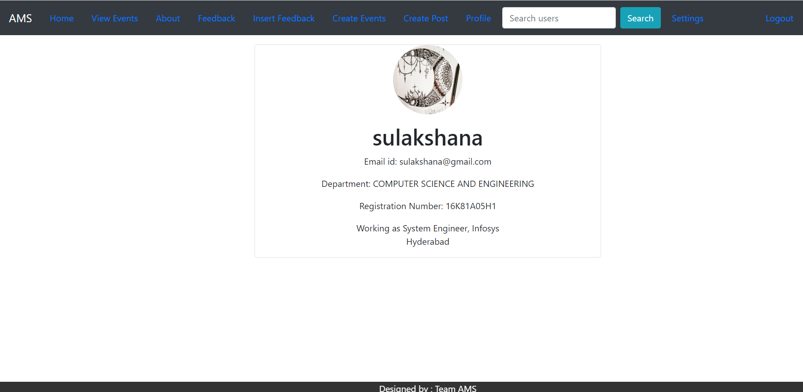
Fig 8 Other User Profile Page
23.05.2020
Department of Computer Science & Engineering 37

Slide 38
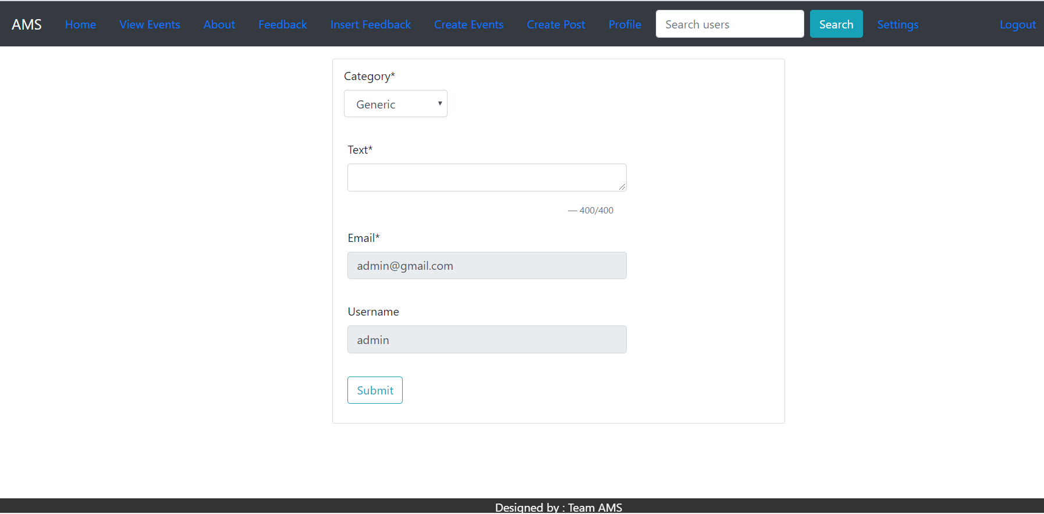
Fig 9 Insert Feedback Page
23.05.2020
Department of Computer Science & Engineering 38

Slide 39
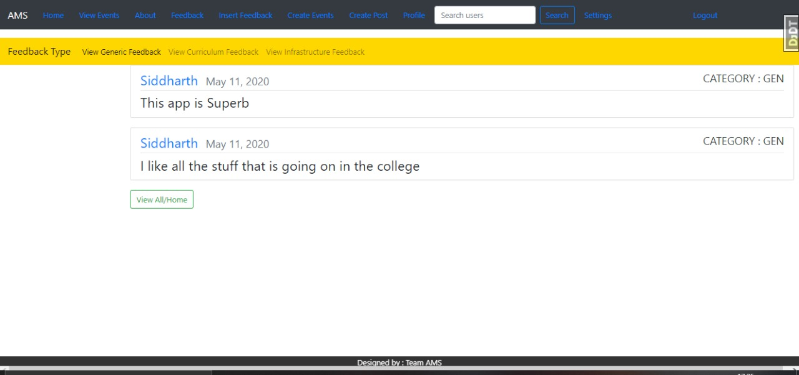
Fig 10 View Feedback Page
23.05.2020
Department of Computer Science & Engineering 39

Slide 40
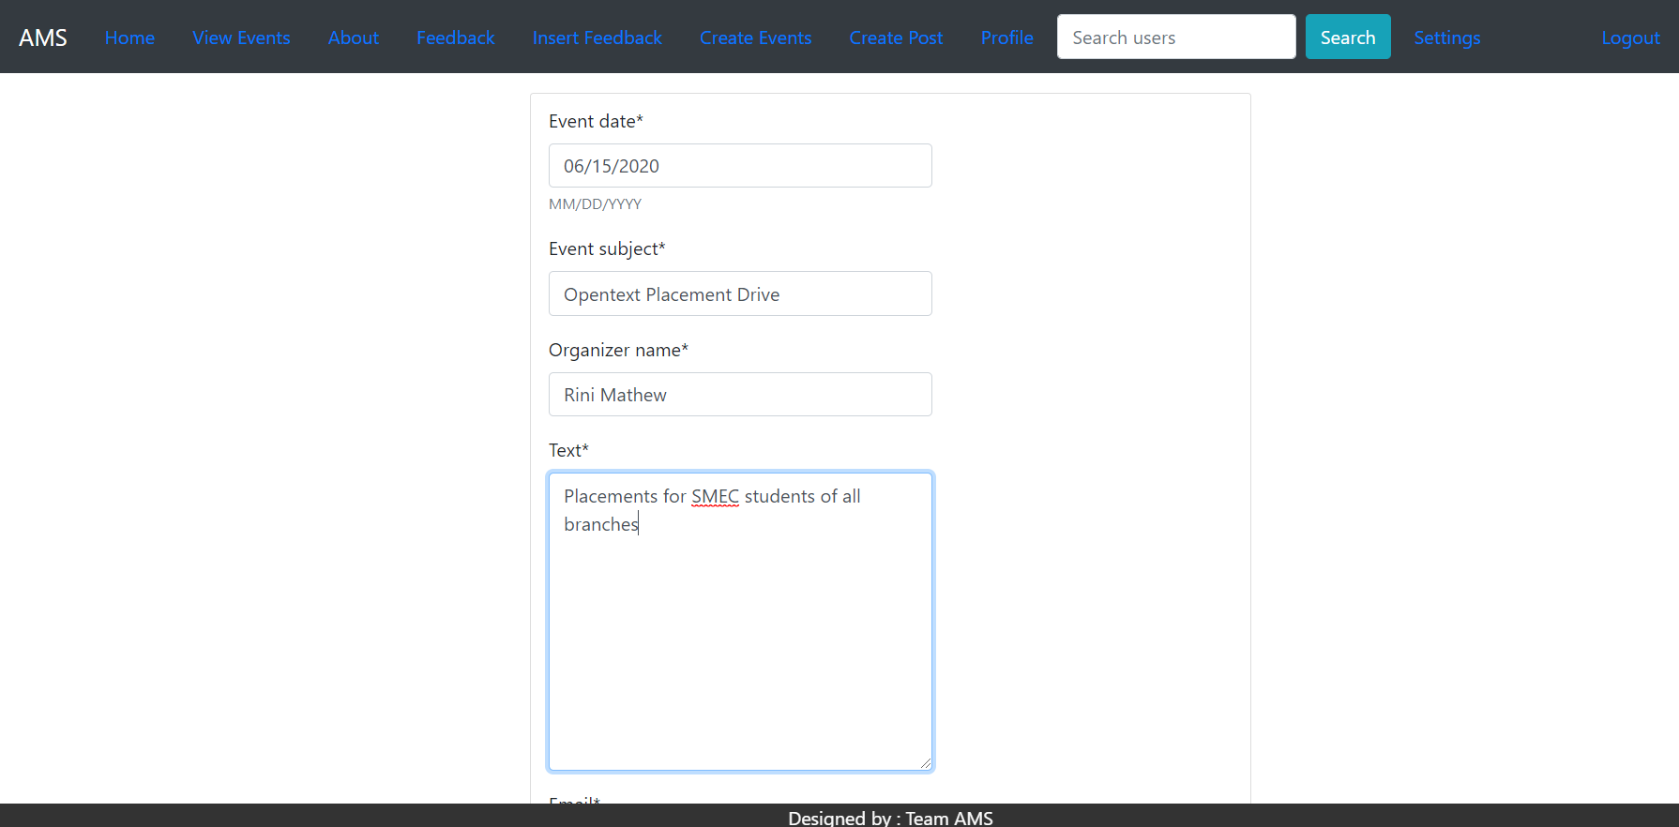
Fig 11 Events Creation Page
23.05.2020
Department of Computer Science & Engineering 40

Slide 41
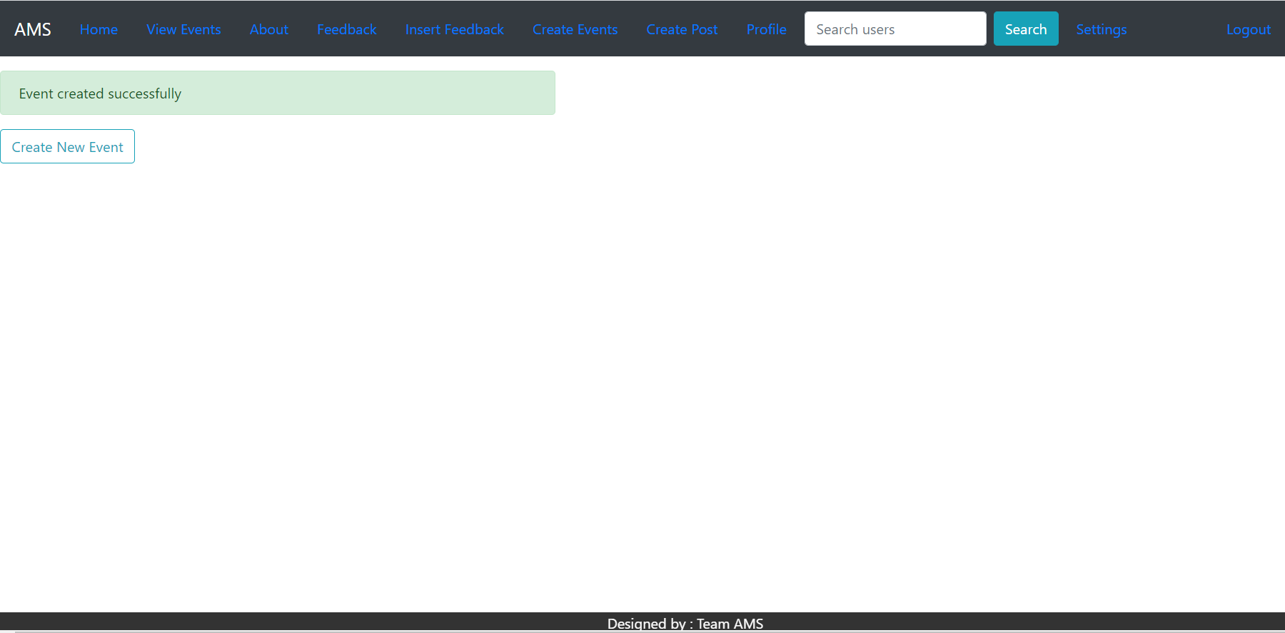
Fig 12 Event Success Message
23.05.2020
Department of Computer Science & Engineering 41

Slide 42
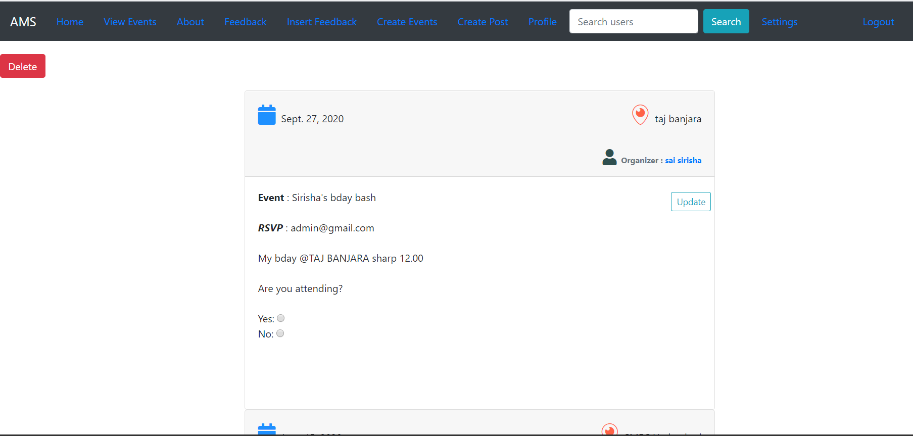
Fig 13 View Events Page
23.05.2020
Department of Computer Science & Engineering 42

Slide 43

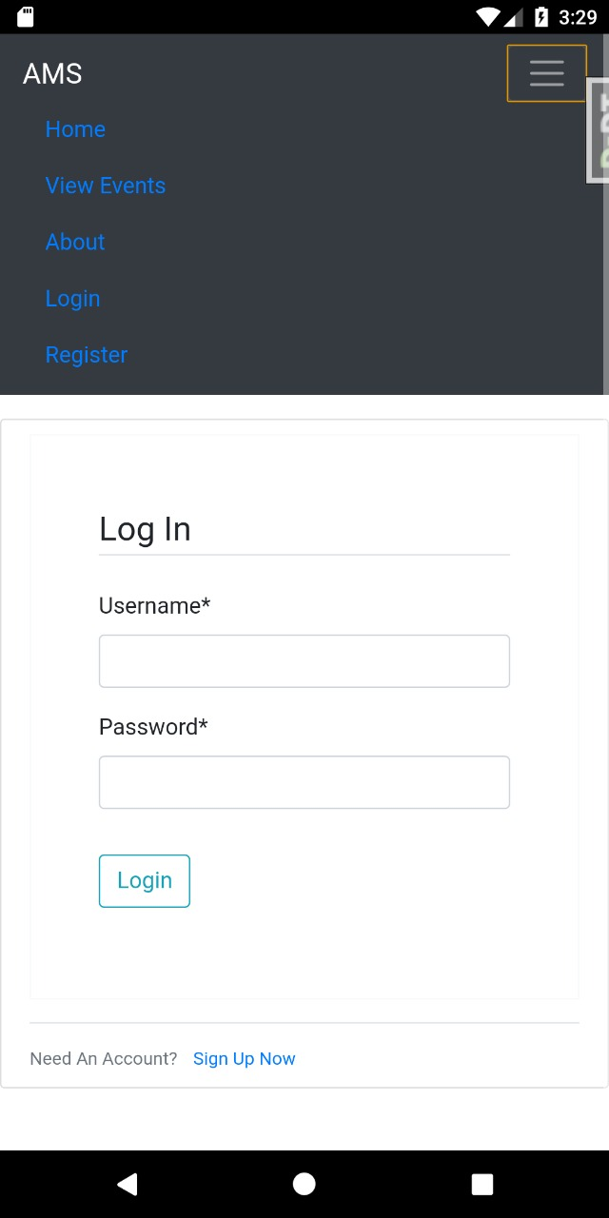
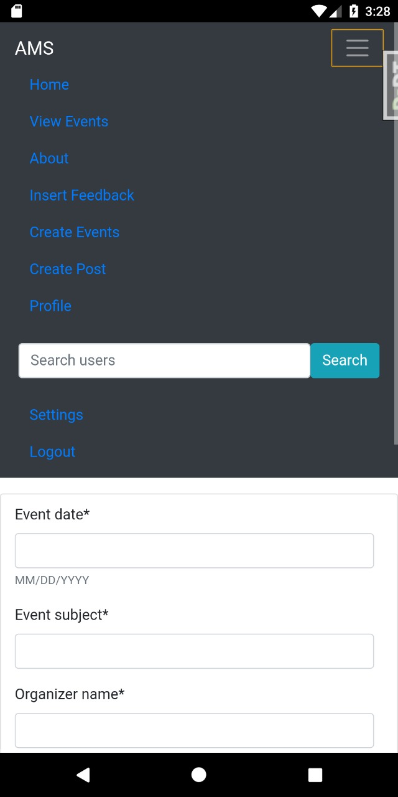
Fig 14 Splash Screen Fig 15 Dropdown before login Fig 16 Dropdown after login
23.05.2020
Department of Computer Science & Engineering 43

Slide 44
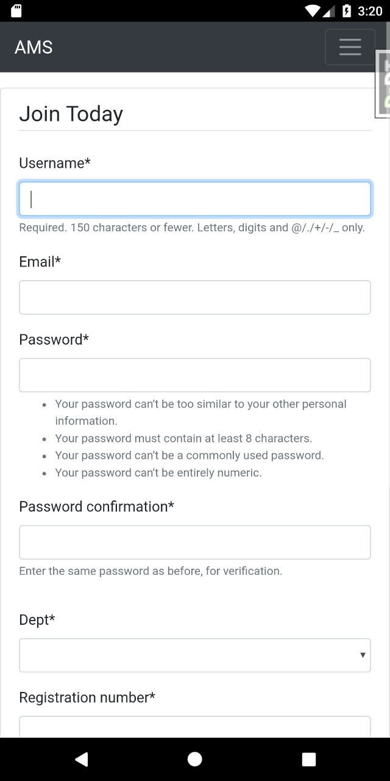
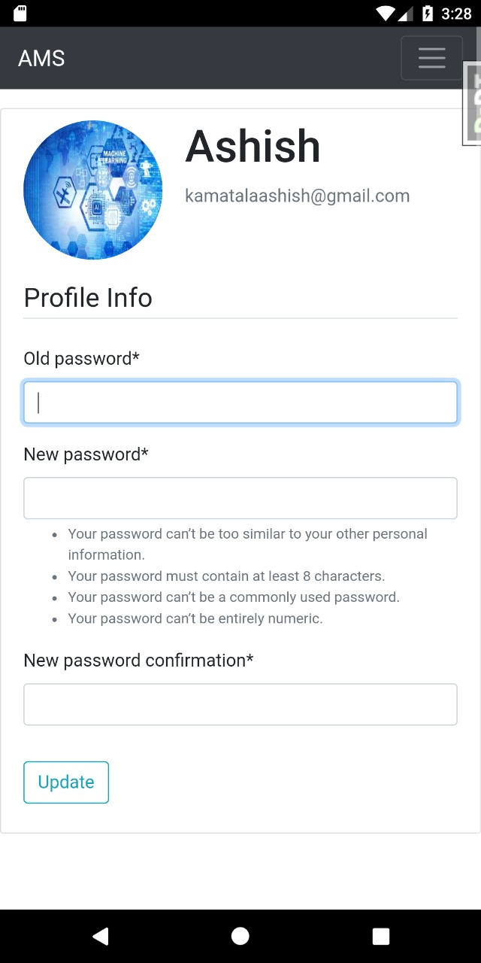
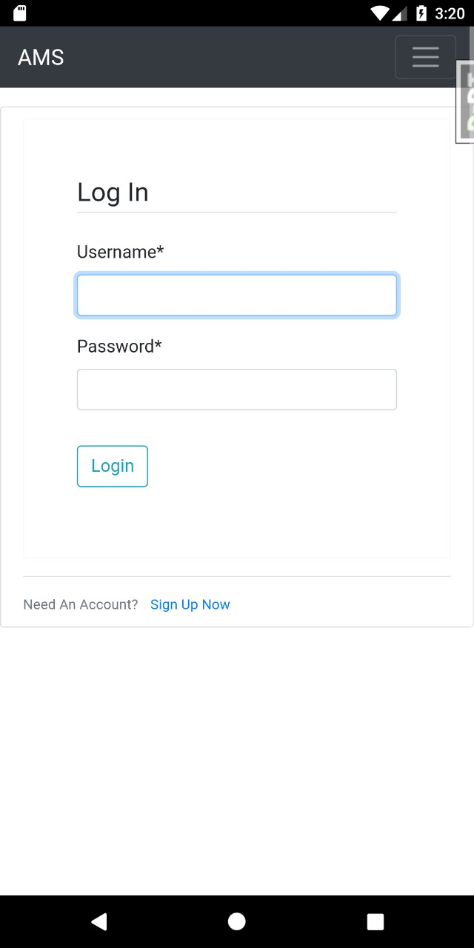
Fig 17 Register Screen Fig 18 Change Password Screen Fig 19 Login Page
23.05.2020
Department of Computer Science & Engineering 44

Slide 45
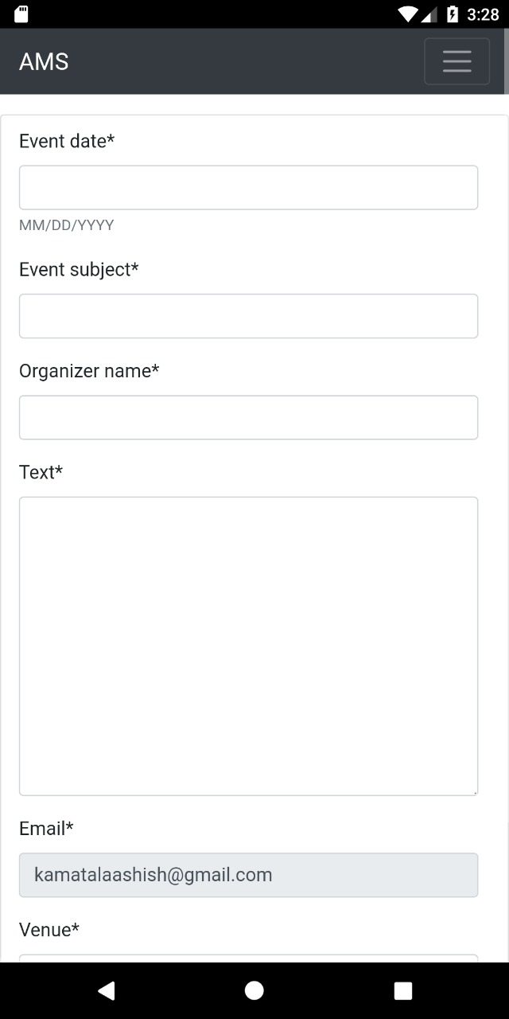
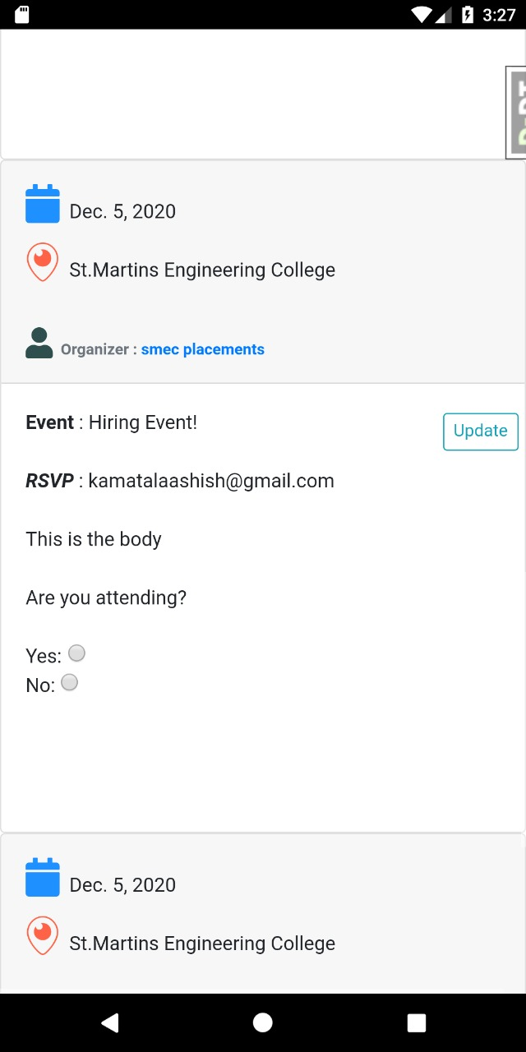
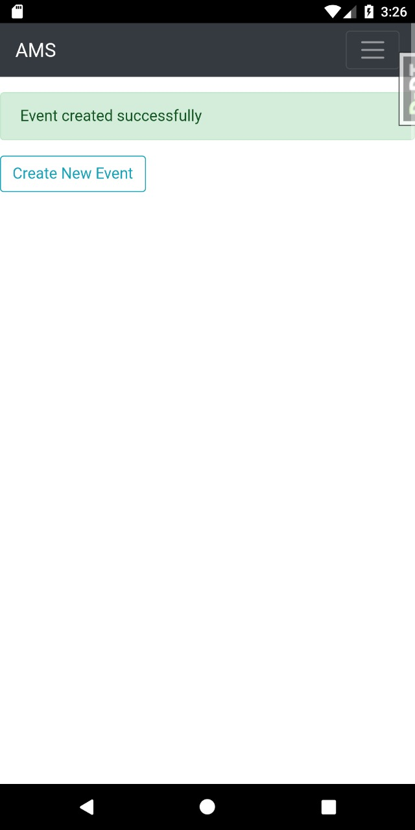
Fig 20 Create Events Screen Fig 21 View Events Page Fig 22 Success Page
23.05.2020
Department of Computer Science & Engineering 45

Slide 46
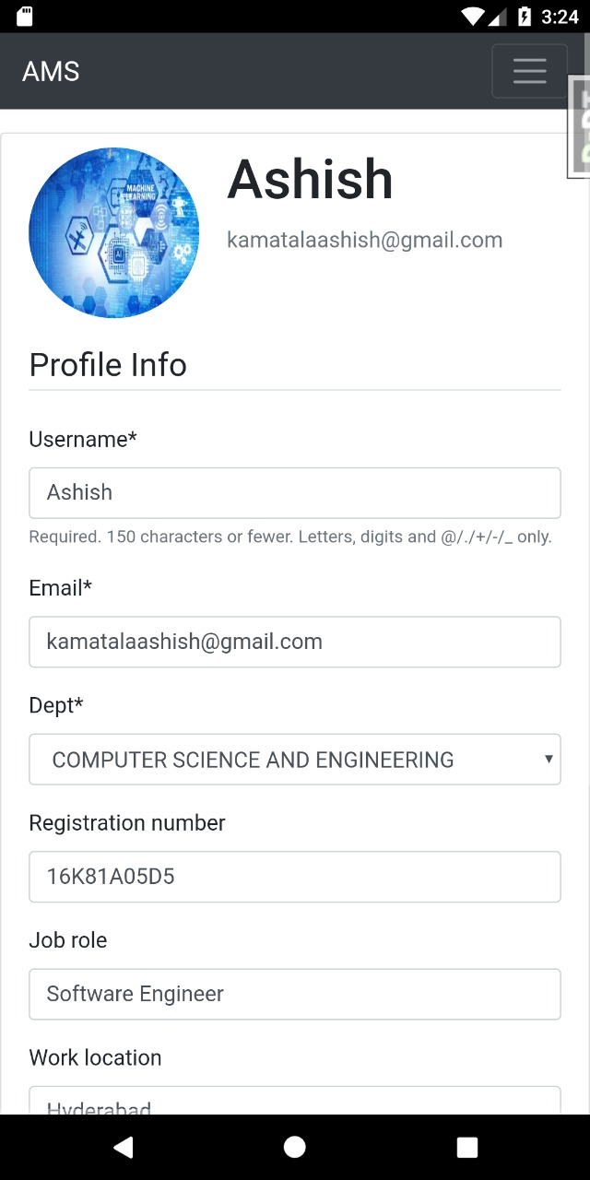
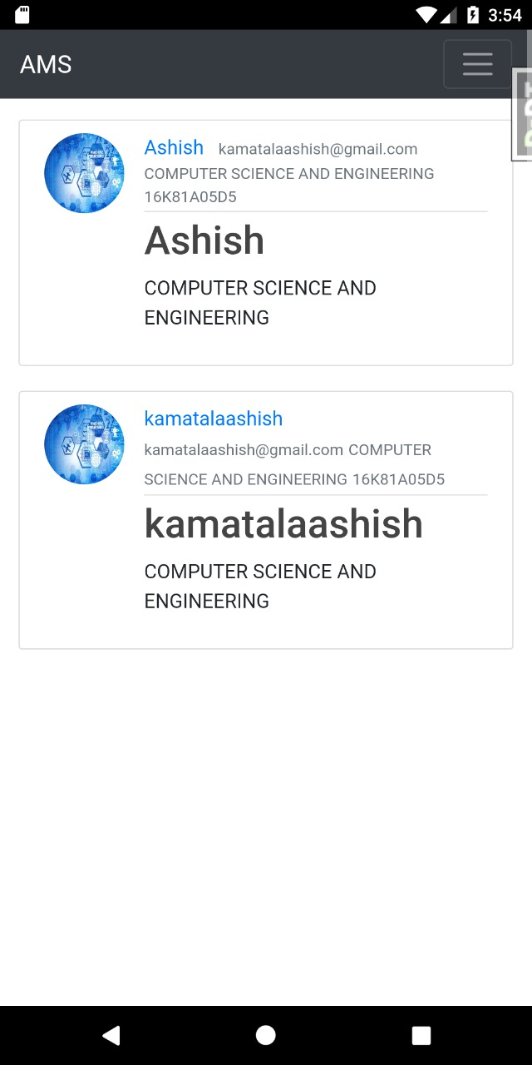
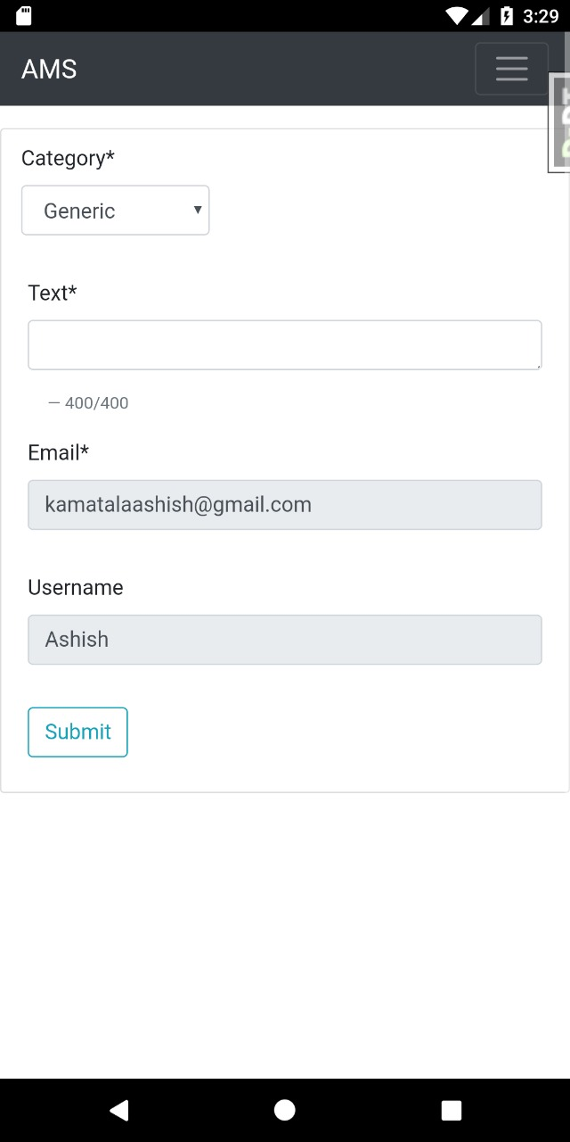
Fig 23 Profile Screen Fig 24 View Blogs Page Fig 25 Insert Feedback Page
23.05.2020
Department of Computer Science & Engineering 46

Slide 47
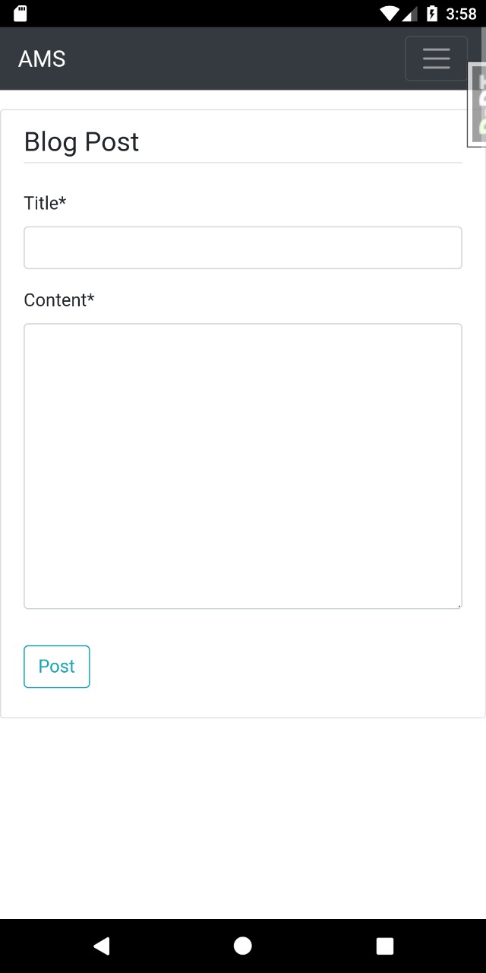
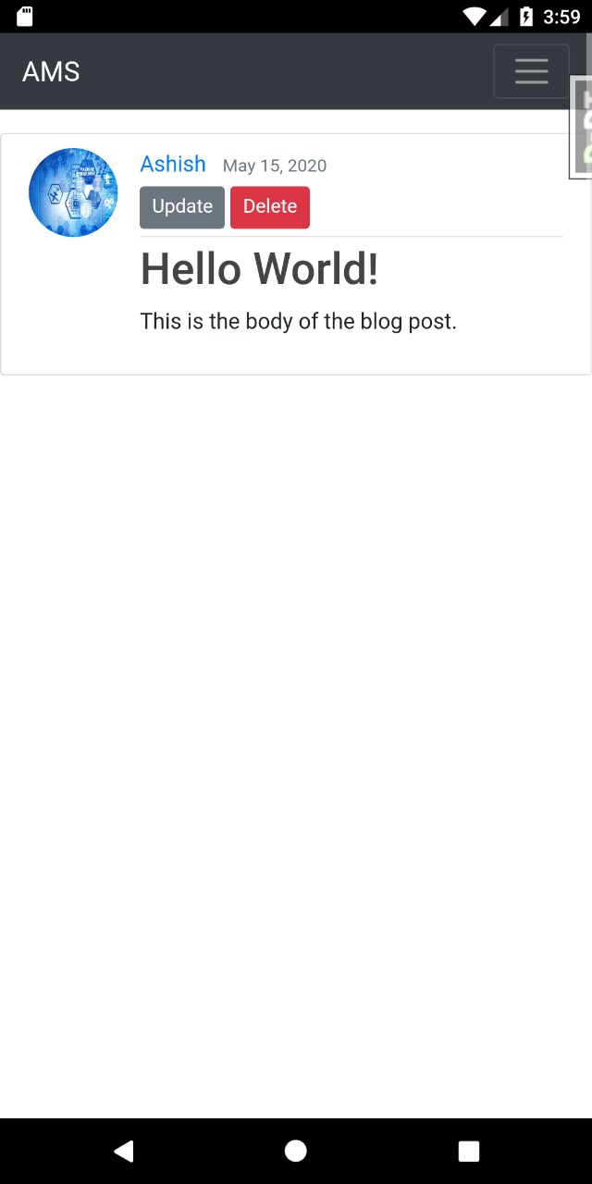
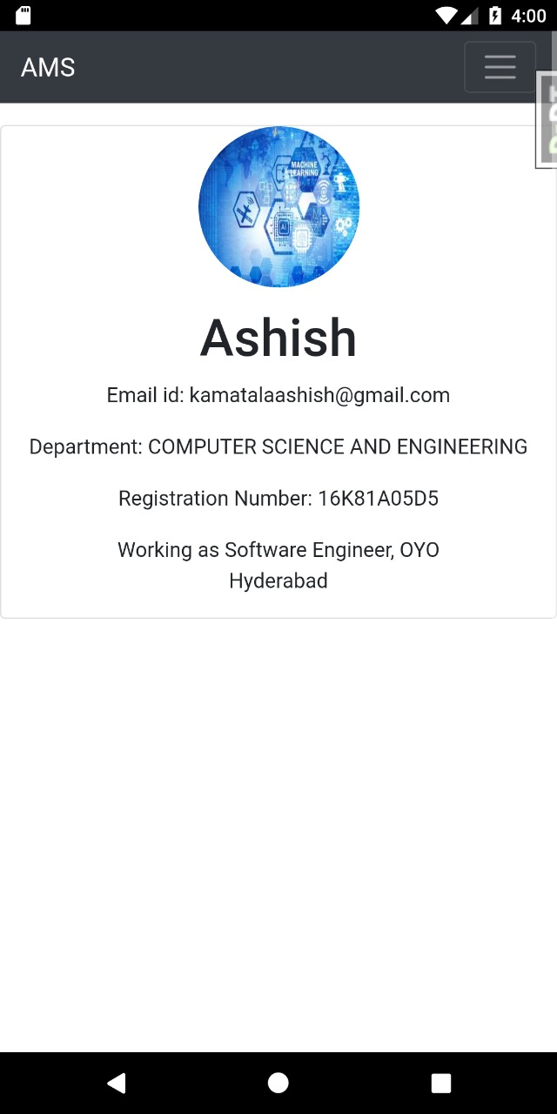
Fig 26 Blog Post Screen Fig 27 View Blogs Page Fig 28 Other User Profile Page
23.05.2020
Department of Computer Science & Engineering 47

Slide 48
Testing
Testing is debugging the program.It is one of the most critical aspects of the computer Programming triggers, without programming that works, the system would never produce an output of which it was designed. Testing is best performed when user development is asked to assist in identifying all errors and bugs. The sample data are used for testing. It is not quantity but quality of the data used the matters of testing. Testing is aimed at ensuring that the system was accurately and efficiently before live operation commands.
Types of Testing:
Code Testing
Specification Testing
Unit Testing
Integration Testing
23.05.2020
Department of Computer Science & Engineering 48

Slide 49
Cont..
Code Testing:
This examines the logic of the program. For example, the logic for updating various sample data and with the sample files and directories were tested and verified.
Specification Testing:
Executing this specification starting what the program should do and how it should perform under various conditions. Test cases for various situation and combination of conditions in all the modules are tested.
Unit Testing:
In the unit testing we test each module individually and integrate with the overall system. Testing focuses verification efforts on the smallest unit of software design in the module. This is also known as module testing.
Integration Testing
In this type of testing we test various integration of the project module by providing the input .The primary objective is to test the module interfaces in order to ensure that no errors are occurring when one module invokes the other module.
23.05.2020
Department of Computer Science & Engineering 49

Slide 50
Cont..
User Acceptance Testing:
Deployed the application on AWS cloud and done user acceptance testing with 30 users and verified that system works fine end to end.Also verified the proper working of the Android application by releasing the APK to the users.
Unit Testing:
Testing user sign up and login page for creating users.
Testing creation of events and notifying through emails.
Testing the successful posting of feedback.
Testing the creation of blogs.
Testing the search users and update profile functionalities.
Integration testing:
Combining all the above functionalities into a single system and testing the proper working of the system which was found to be satisfactory.
23.05.2020
Department of Computer Science & Engineering 50

Slide 51
Conclusion and Limitations of Proposed System
The alumni management system that we propose is a centralized system for a university.
Any alumnus of the university can register to the system.
It removes the toil of hard work required in maintain records about the alumni.
This system can be accessed from any website or mobile phone that is compatible.
This system lets students currently enrolled in the university to connect with the alumni in an efficient manner.
They can choose to connect to people based on their job profile, location, company working for etc.
23.05.2020
Department of Computer Science & Engineering 51

Slide 52
Challenges of the Proposed System
Updating and reminding users to update their profiles in timely manner
Time commitment from leaders
Informing new users about the events that are going to be held in future about which the notifications are already sent out.
Real time chat and video conference among users and alumni.
Providing a platform to ease the complete recruitment process online
Resume filtering mechanism to process applications and find eligible candidates
Getting users to attend the events
23.05.2020
Department of Computer Science & Engineering 52

Slide 53
Future Work
The future work that can be done in the system:
Addition of chatting feature that allows users to communicate with each other.
Users can choose to hide or block some user in chatting.
The users can get a detailed summary of the alumni placed in big tech giants or with highest packages.
The results of recruitment events can be posted on the system.
The system can be configured to generate a resume by asking the users to fill up some columns or forms or based upon the profile.
They can connect via Linkedin profiles also. There can be an option provided for the users to communicate with each other using Linkedin to get referrals.
The system can be used to take online interviews by creating a video calling feature, that might help people to give referrals to the eligible candidates after conducting screening rounds.
We can give premium accounts for users so they can access advanced features like going live on system, webinars access etc.
23.05.2020
Department of Computer Science & Engineering 53

Slide 54
References
[1] N Rubens et al., "Alumni network analysis," in IEEE Global Engineering Education Conference (EDUCON), 2011, pp. 606- 611.
[2] Centralized Alumni Management System (CAMS) - A Prototype Proposal
IEEE, Dept. of CSE, Techno International Batanagar, Kolkata, India
[3] K Sivaprasad, "Making best use of alumni associations for holistic development of engineering institutes," in IEEE International Conference on Engineering Education: Innovative Practices and Future Trends (AICERA), 2012, pp. 1-11.
[4] Almabay. [Online]. HYPERLINK "https://www.almabay.com/" https://www.almabay.com/
[5] AlmaConnect. [Online]. HYPERLINK "https://www.almaconnect.com/" https://www.almaconnect.com/
[6] Alumnet. [Online]. HYPERLINK "https://www.alumnet.co.za/" https://www.alumnet.co.za/
[7] almabase. [Online]. HYPERLINK "https://www.almabase.com/" https://www.almabase.com/
[8] J E Sharp, "Work in progress: alumni mentoring of engineers in a technical communication course," in 34th Annual Frontiers in Education, 2004, pp. F2F-11.
[9] J L Huff, W C Qakes, and C B Zoltowski, "Work in progress: Understanding professional competency formation in a servicelearning context from an alumni perspective," in 2012 Frontiers in Education Conference Proceedings, 2012, pp. 1-3.
[10] J E Sharp, "Work in Progress: Using Mock Telephone Interviews with Alumni to Teach Job Search Communication," in Frontiers in Education. 36th Annual Conference, 2006, pp. 7- 8.
23.05.2020
Department of Computer Science & Engineering 54

Slide 55
Thank you!
..Team AMS
23.05.2020
Department of Computer Science & Engineering 55

